Slide 1
Design and Implement Cloud Data Platform Solutions

Slide 2
05 | Hybrid HA/DR Scenarios with SQL Server

Slide 3
Agenda
1
Microsoft Cloud Data Platform
5
Hybrid HA/DR Scenarios with SQL Server
2
Implement SQL Server on Azure VM
6
Design and Implement Security
3
Implement SQL Database
7
Monitor and Manage Implementations on Azure
4
SQL Database High Availability and Disaster Recovery
8
Design and Implement Database Solutions for SQL Server and SQL Database

Slide 4
In this module
HA/DR deployment architectures
Log Shipping
AlwaysOn availability groups
Backup to Azure
AlwaysOn Failover Clustering
Managed Backups
Database Mirroring
SQL Server data files on Azure

Slide 5
HA/DR deployment architectures
AlwaysOn Availability Groups
AlwaysOn Failover Clustering
Database Mirroring
Log Shipping
Backup to Azure (blob storage)
Azure Site Recovery
Azure Only Availability replicas running across multiple datacenters in Azure VMs for disaster recovery.
Cross-region solution protects against complete site outage.
Hybrid
Some replicas running in Azure VMs and other replicas running on-premises for cross-site disaster recovery.
HA only, not DR FCI on a two-node WSFC running in Azure VMs with storage supported by a third-party clustering solution.
FCI on a two-node WSFC running in Azure VMs with remote iSCSI Target shared block storage via ExpressRoute.
Azure Only Principal and mirror and servers running in different datacenters for disaster recovery.
Principal, Mirror, and Witness run within same Azure data center, deployed using a DC or server certificates for HA.
Hybrid One partner running in an Azure VM and the other running on-premises for cross-site disaster recovery using server certificates.
For DR only / Hybrid
One server running in an Azure VM and the other running on-premises for cross-site disaster recovery.
Log shipping depends on Windows file sharing, so a VPN connection between the Azure virtual network and the on-premises network is required.
Requires AD deployment on DR site.
On-premises production databases backed up directly to Azure blob storage for disaster recovery.
Simpler BCDR story
Site Recovery makes it easy to handle replication, failover and recovery for your on-premises workloads and applications.
Flexible replication You can replicate on-premises servers, Hyper-V virtual machines, and VMware virtual machines.
Eliminate the need for secondary

Slide 6
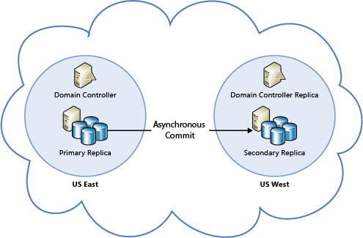
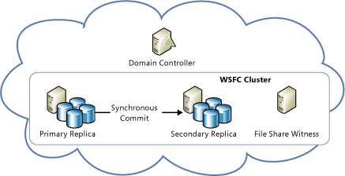
AlwaysOn Availability Groups
AlwaysOn Availability Groups
Azure Only Availability replicas running across multiple datacenters in Azure VMs for disaster recovery.
Cross-region solution protects against complete site outage.
Hybrid
Some replicas running in Azure VMs and other replicas running on-premises for cross-site disaster recovery.
All availability replicas running in Azure VMs for high availability within the same region. You need to configure a domain controller VM, because Windows Server Failover Clustering (WSFC) requires an Active Directory domain. For more information, see Configure AlwaysOn Availability Groups in Azure (GUI).
Availability replicas running across multiple datacenters in Azure VMs for disaster recovery. This cross-region solution protects against complete site outage. Within a region, all replicas should be within the same cloud service and the same VNet. Because each region will have a separate VNet, these solutions require VNet to VNet connectivity. For more information, see Configure a Site-to-Site VPN
COVER AVAILABILITY SETS

Slide 7
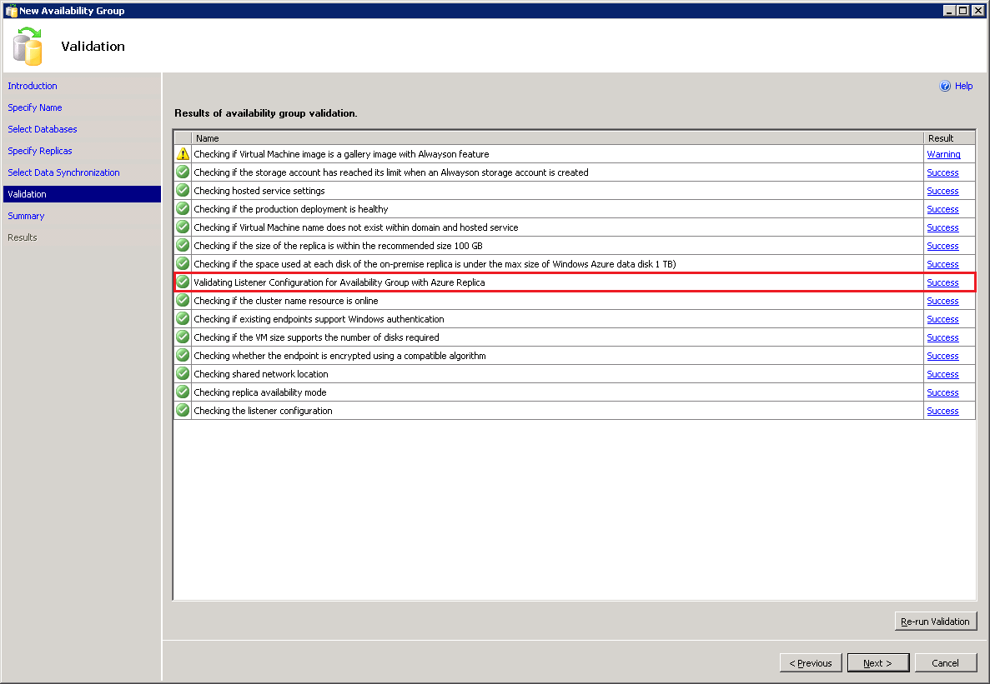
Add Azure Replica Wizard
Automatic Listener Configuration
Today:
Requires manual configuration of the Listener
In SQL Server 2016:
Ability to configure the Availability Group Listener in Azure
Clients can connect to the Azure replica after failover using the Listener name

Slide 8
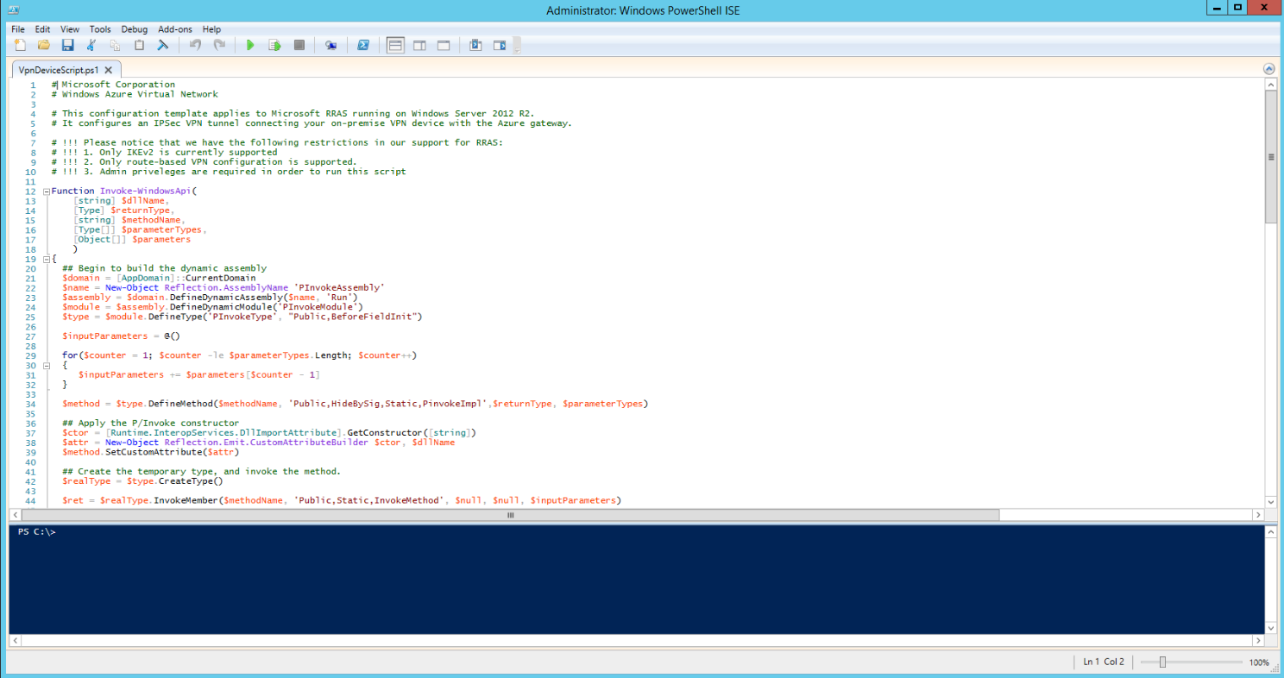
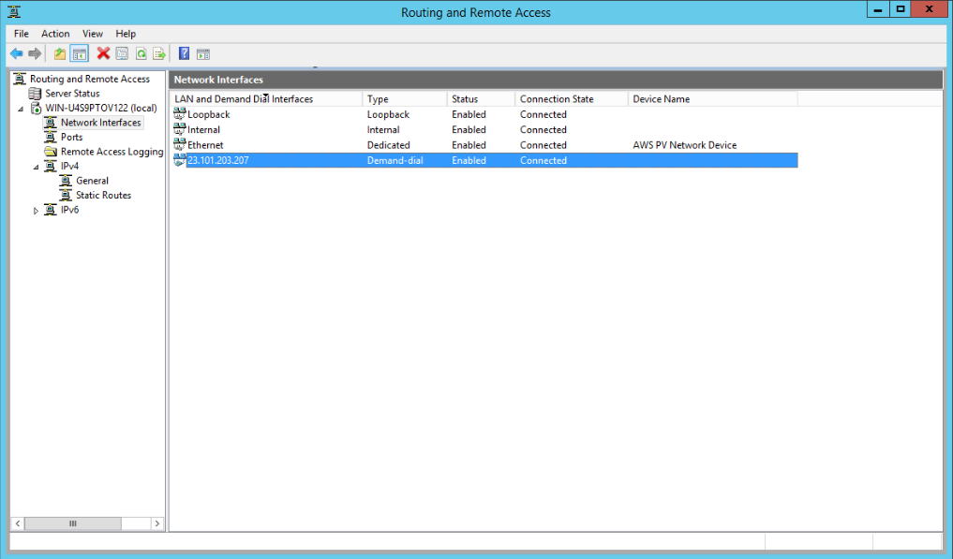
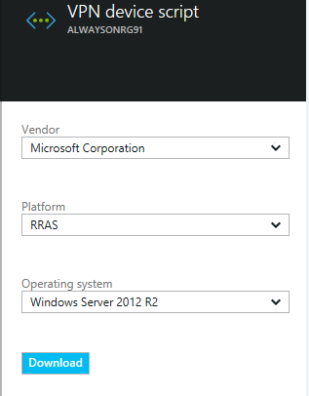
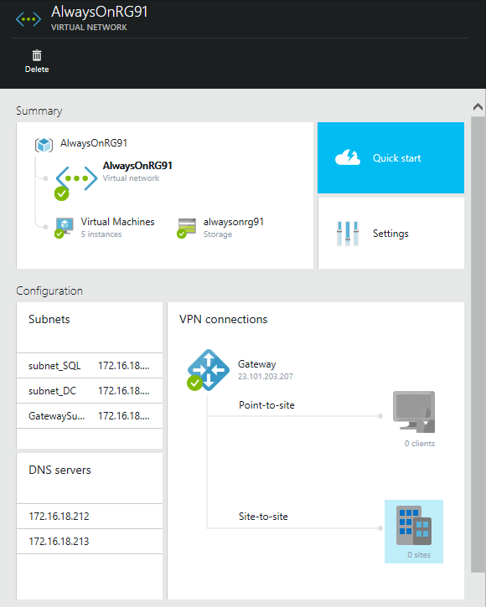
Before extending AlwaysOn configuration
Configure site-to-site VPN tunnel between on-premises SQL Server and Azure
Tutorial: http://msdn.microsoft.com/en-us/library/dn636917.aspx

Slide 9
AlwaysOn replica in Azure
Sample deployment
Availability Group
Virtual Network
S1
VPN Tunnel
S2
P
AD/DNS
VPN Device
VPN Gateway
AGCloudReplica
On-premises
Microsoft Azure

Slide 10
Demo
AlwaysOn Availability Groups on Azure

Slide 11
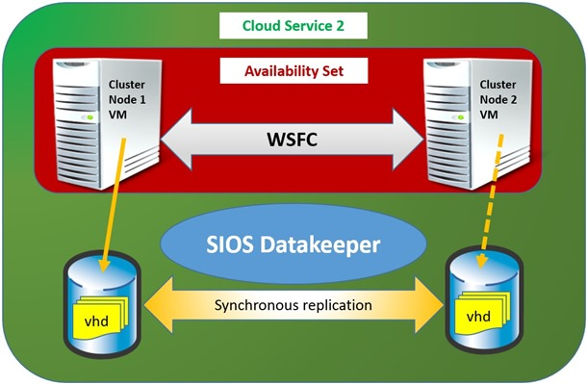
AlwaysOn Failover Clustering
Always On Failover Clustering
HA only, not DR FCI on a two-node WSFC running in Azure VMs with storage supported by a third-party clustering solution.
FCI on a two-node WSFC running in Azure VMs with remote iSCSI Target shared block storage via ExpressRoute.
FCI on a two-node WSFC running in Azure VMs with storage supported by a third-party clustering solution.
An FCI on a two-node WSFC running in Azure VMs with remote iSCSI Target shared block storage via ExpressRoute. For example, NetApp Private Storage (NPS) exposes an iSCSI target via ExpressRoute with Equinix to Azure VMs. For third-party shared storage and data replication solutions, you should contact the vendor for any issues related to accessing data on failover. Note that using FCI on top of Azure File storage is not supported yet, because this solution does not utilize Premium Storage. We are working to support this soon.

Slide 12
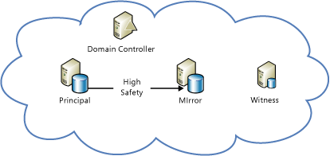
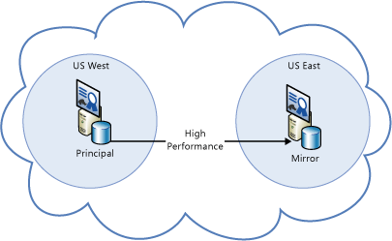
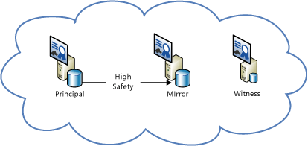
Database Mirroring
Database Mirroring
Azure Only Principal and mirror and servers running in different datacenters for disaster recovery.
Principal, Mirror, and Witness run within same Azure data center, deployed using a DC or server certificates for HA.
Hybrid One partner running in an Azure VM and the other running on-premises for cross-site disaster recovery using server certificates.
Principal and mirror and servers running in different datacenters for disaster recovery. You must deploy using server certificates because an Active Directory domain cannot span multiple datacenters.

Slide 13
Backup to Azure
Backup to Azure (blob storage)
On-premises production databases backed up directly to Azure blob storage for disaster recovery.
Supports compression and encryption.
Block blobs
Reduced storage costs
Significantly improved restore performance
More granular control over Azure Storage
Azure Storage snapshot backup
Fastest method for creating backups and running restores
Support of SQL Server database files on Azure Blob Storage
Managed backup
Granular control of the backup schedule
Local staging for faster recovery and greater network resiliency
System database support
Simple recovery mode support
CREATE CREDENTIAL [https://<account>.blob.core.windows.net/<container>]
WITH IDENTITY = 'Shared Access Signature',
SECRET = 'sig=mw3K6dpwV%2BWUPj8L4Dq3cyNxCI'
BACKUP DATABASE database TO
URL = N'https://<account>.blob.core.windows.net/<container>/<blob1>',
URL = N'https://<account>.blob.core.windows.net/<container>/<blob2>'

Slide 14
Demo
Backup to URL

Slide 15
SQL Server data files in Azure
SQL Server 2014
Near “bottomless” storage
Off-site, geo-redundant
No provisioning
No device management
Media safety (decay free)
Remote accessibility
Native support for SQL Server data files stored as Azure blobs
DB1
DB2
DB3
DB3
Azure Virtual Machines
Azure Storage
DB4
DB5
DB6
DB6
On-premises
CREATE CREDENTIAL [https://mystorage.blog.core.windows.net/data]
WITH IDENTITY = ‘Shared Access Signature',
SECRET = ‘<your SAS key>
CREATE DATABASE mydb ON
( NAME = mydb_dat,
FILENAME = 'https://mystorage.blob.core.windows.net/data/mydb.mdf' )
LOG ON
( NAME = foo_log,
FILENAME = 'https://mystorage.blob.core.windows.net/data/mydblog.ldf')
Separation of compute and storage
Database migration to other machines
Basic disaster recovery
Increased storage on Azure Virtual Machines

Slide 16
SQL Server 2016: Backup to Azure with file snapshots
SQL Server data files
MDF
MDF
BAK
LDF
LDF
Database
Azure Storage
BACKUP DATABASE database TO URL = N'https://<account>.blob.core.windows.net/<container>/<backupfileblob1>‘ WITH FILE_SNAPSHOT

Slide 17
Point-in-time restore with file snapshots
SQL Server 2016
Full
Log
Log
Log
Diff
Log
Log
Log
Diff
Log
Log
Log
Traditional backup
Multiple backup types
Complex point-in-time restore process
Full
Log
Log
Log
Log
Log
Log
Log
Log
Log
Log
Log
Backup to Azure with file snapshots
Full backup only once
Point-in-time restore only needs two adjacent backups

Slide 18
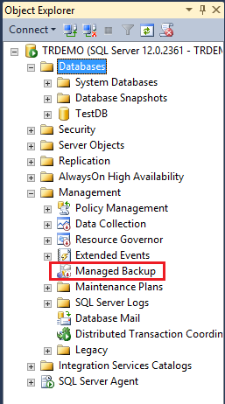
SQL Server 2014 Managed Backup to Azure
What is it?
An agent that manages and automates SQL Server backup policy
Benefits
Simple and flexible
Minimal input (controls retention period)
Manages entire instance or individual databases
Leverages backup to Azure (page blob)
Supports backup encryption
Inherently off-site and geo-redundant
Minimal storage cost and hardware management
Built-in intelligence
Retention
Context-aware (for example, workload/throttling)
Backups consider log accumulation
Example:
EXEC smart_admin.sp_set_db_backup
@database_name='TestDB',
@retention_days=30,
@credential_name='MyCredential',
@encryption_algorithm='NO_ENCRYPTION',
@enable_backup=1
GO

Slide 19
Managed Backup to Azure in SQL Server 2016
Supports system databases
Supports databases in simple recovery mode
Leverages backup to block blobs for more granular control
Allows customized backup schedules for full backup and log backup

Slide 20
Managed Backup to Azure in SQL Server 2014
Prerequisites
SQL credential based on Azure Storage account
Enable SQL Server Agent
Backup logic
Full: 1 week, or 1 GB log growth; initial and log chain broken
Log: 2 hours, or 5 MB log growth
Retention
Up to 30 days (capable of point-in-time recovery)
Limitations
Full and log backups only
Recovery models: full or bulk-logged
User databases only
Max backup size of 1 TB (Azure page blob limit)

Slide 21
High Availability Best Practices
Configure a SQL HA technology (AlwaysOn / Database Mirroring) if
You want failure detection for SQL Server (e.g., service down)
You can’t stand recovery times due to Service Healing (12 minutes couple of times p/month) or Azure monthly upgrades (15 minutes p/month)
Put replicas in the same
Availability Set (Different Racks and Upgrade Domains)
VNet (Maintain VM IPs)
Use secondary replicas to offload reads/backups
Load balance using Windows Azure’s Load Balancer

Slide 22
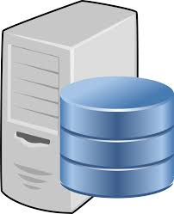
A sample configuration
Availability Group
Automatic Failover
P
S1
S2
(Readable)
S3
(Readable)
S4
(Readable)
Listener
Azure Load Balancer
OLTP App
Reporting App
Reporting App
Reporting App

Slide 23
Connectivity Best Practices
Remove unused endpoints on the virtual machine
Use endpoint ACLing to control connections
Don’t disable Windows Firewall
If clients are in Azure, host them in same VNET as SQL Server
If Windows Authentication is needed:
Configure Domain Controller
Configure a VPN tunnel from on-premises and use on-premises Domain Controller
If not, use SQL authentication

Slide 24
Hands-on Lab
Implement HA/DR with SQL Server in Azure VMs

